Slide 1

Chapter 5.3
Delay System M/GI/1
Performance Evaluation of the Internet of Things (IoT)
Module Course: Performance Evaluation of Distributed Systems
Prof. Tobias Hoßfeld, Summer Semester 2022

Slide 2
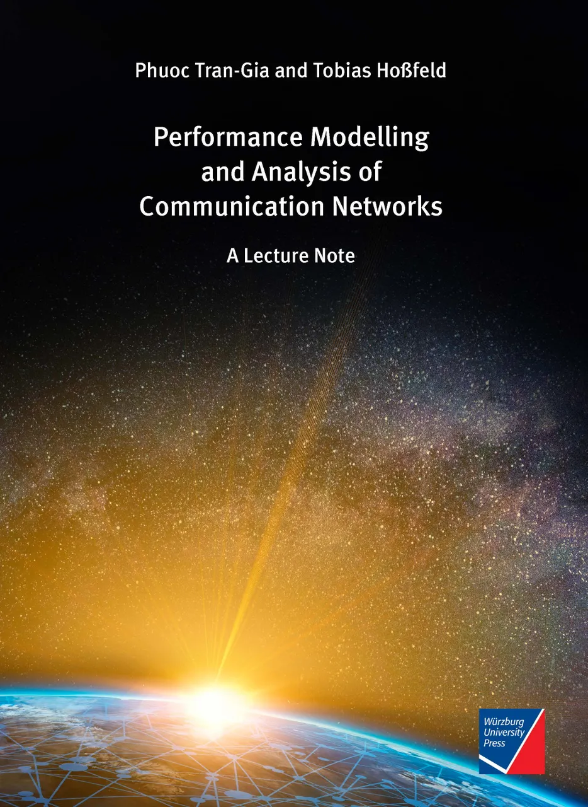
Disclaimer and Copyright Notice
Lecture slides, figures, and scripts are based on the open access text book “Performance Modeling and Analysis of Communication Networks”. The book and scripts are licensed under the Creative Commons License Attribution-ShareAlike 4.0 International (CC BY-SA 4.0). If you remix, transform, or build upon the material, you must distribute your contributions under the same license as the original.
The book must be cited and the disclaimer attached when using lectures slides or scripts.
Tran-Gia, P. & Hossfeld, T. (2021). Performance Modeling and Analysis of Communication Networks - A Lecture Note. Würzburg University Press. https://doi.org/10.25972/WUP-978-3-95826-153-2
Website to download book, exercises, slides and scripts: https://modeling.systems/

Slide 3
Chapter 5
5 Analysis of Non-Markovian Systems
5.1 Discrete-Time Markov Chain
5.2 Method of Embedded Markov Chain
5.2.1 Power Method for Numerical Derivation
5.2.2 Notion of Embedding Times
5.2.3 Kleinrock’s Result
5.3 Delay System M/GI/1
5.3.1 Model Structure and Parameters
5.3.2 Markov Chain and State Transition
5.3.3 State Equation
5.3.4 State Probabilities
5.3.5 Delay Distribution
5.3.6 Other System Characteristics
5.3.7 State Probabilities at Arbitrary Time
5.4 Delay System GI/M/1
5.4.1 Model Structure and Parameters
5.4.2 Markov Chain and State Transition
5.4.3 State Probabilities
5.4.4 State Analysis with Geometric Approach
5.4.5 Waiting Time Distribution
5.5 Model with Batch Service and Threshold Control
5.5.1 Model Structure and Parameters
5.5.2 Markov Chain and State Transition
5.5.3 State Probabilities and System Characteristics
5.6 Results for Continuous-Time GI/GI/1 Delay Systems
5.6.1 Characteristics of GI/GI/1 Delay Systems
5.6.2 Lindley Integral Eq. GI/GI/1 Systems
5.6.3 Kingman’s Approximation of Mean Waiting Times

Slide 4
Model Structure and Parameters

Slide 5
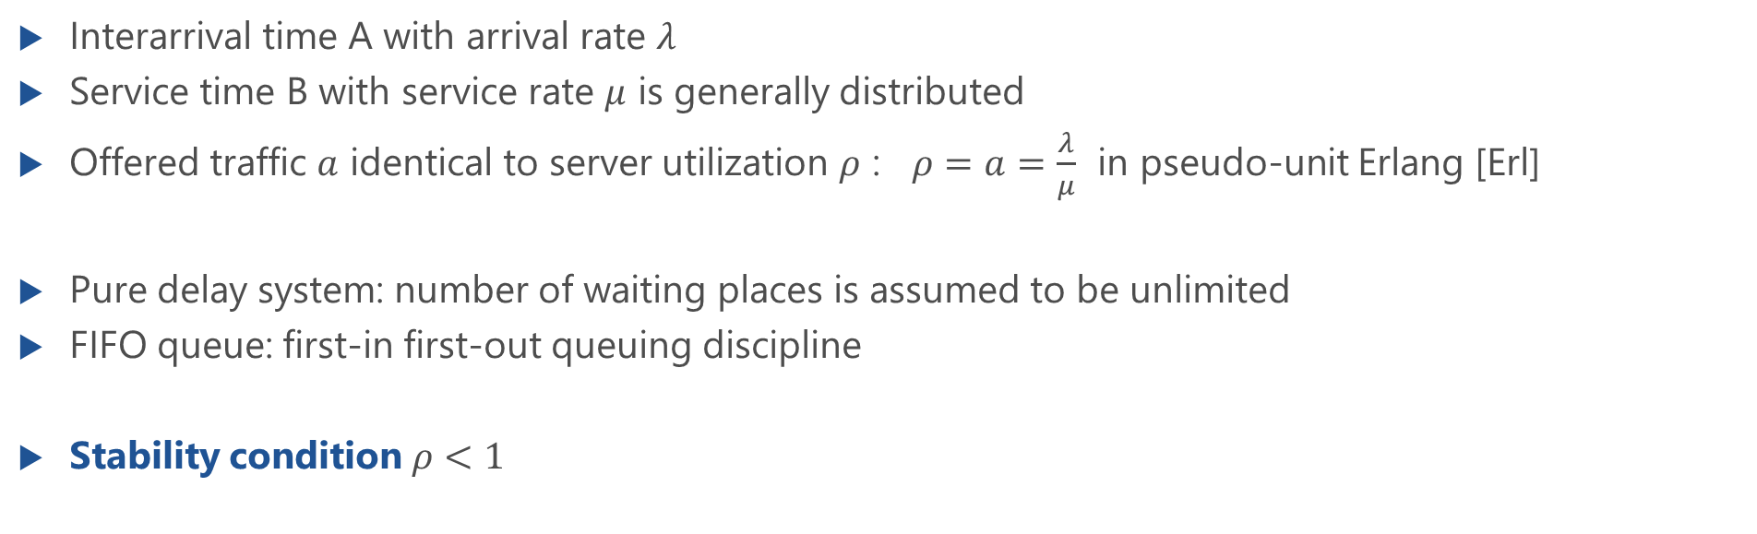
Delay System M/GI/1
Interarrival time A with arrival rate $λ$
Service time B with service rate $μ$ is generally distributed
Offered traffic $a$ identical to server utilization $ρ$ : $ρ=a=\frac{λ}{μ}$ in pseudo-unit Erlang [Erl]
Pure delay system: number of waiting places is assumed to be unlimited
FIFO queue: first-in first-out queuing discipline
Stability condition $ρ<1$

Slide 6
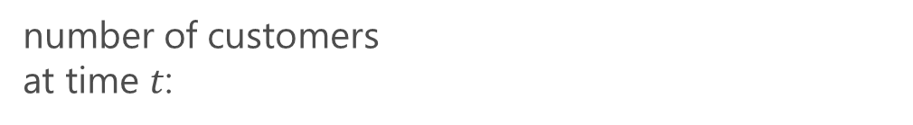
State Process of M/GI/1 (FIFO)
number of customers at time $t$:
Markov chain: $\{X\left(t_{0}\right),X\left(t_{1}\right),…,X\left(t_{n}\right),X\left(t_{n+1}\right), …\}$

Slide 7
Markov Chain and State Transition

Slide 8
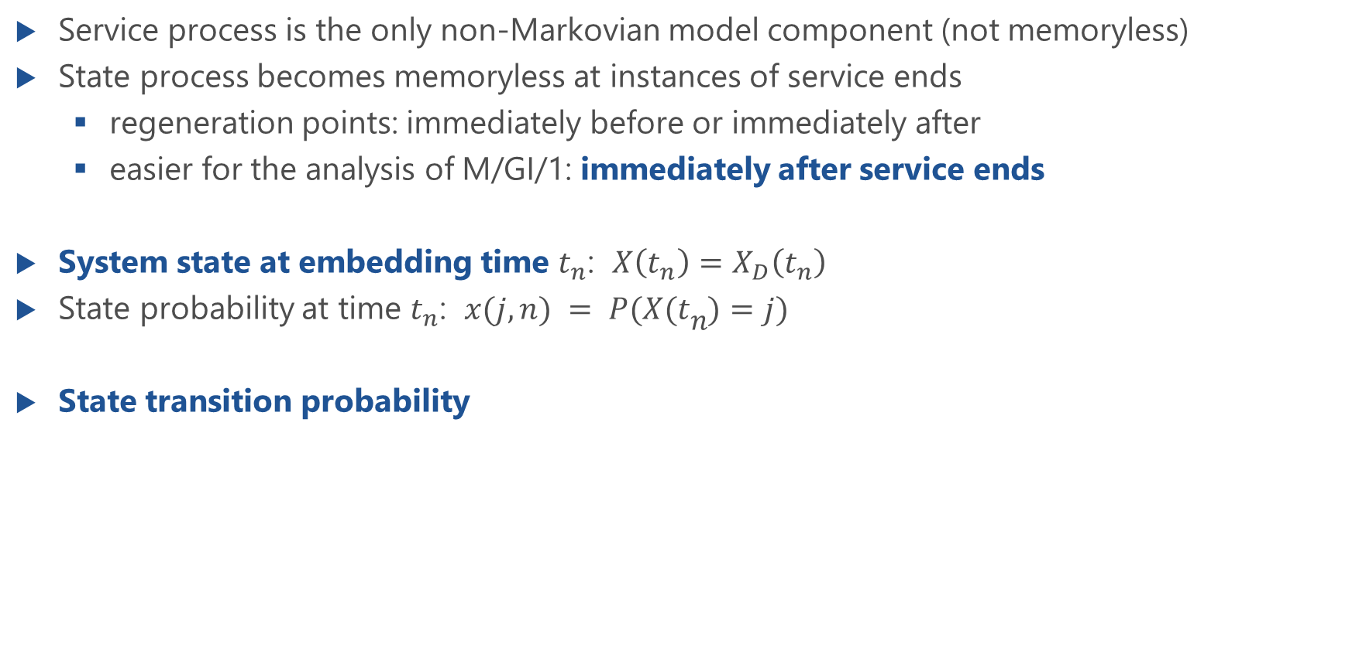
M/GI/1: Embedded Markov Chain
Service process is the only non-Markovian model component (not memoryless)
State process becomes memoryless at instances of service ends
regeneration points: immediately before or immediately after
easier for the analysis of M/GI/1: immediately after service ends
System state at embedding time $t_{n}$: $X\left(t_{n}\right)=X_{D}\left(t_{n}\right)$
State probability at time $t_{n}$: $x(j, n) = P(X(tn)=j)$
State transition probability
state transition
p
ij
j
i
2
2
1
1
0
0
t
n
t
n+1

Slide 9
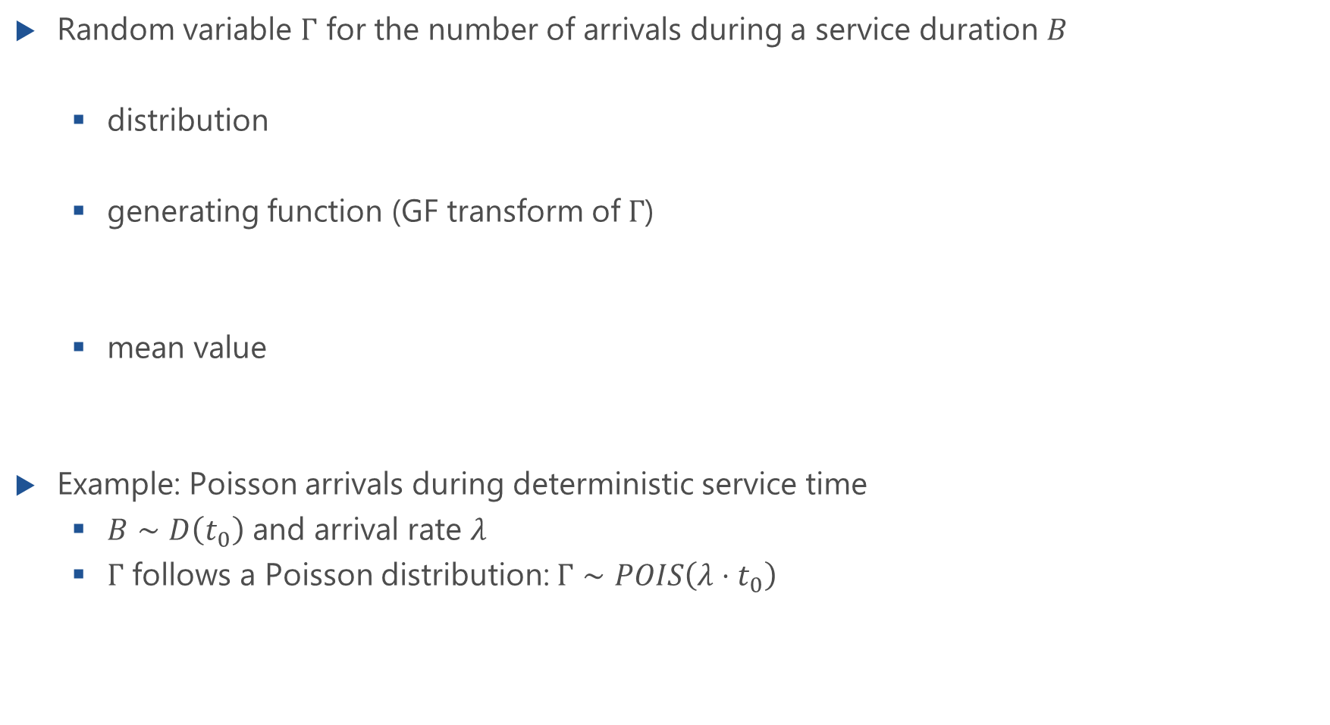
Number of Arrivals During Service Time
Random variable $Γ$ for the number of arrivals during a service duration $B$
distribution
generating function (GF transform of $Γ$)
mean value
Example: Poisson arrivals during deterministic service time
$B∼D\left(t_{0}\right)$ and arrival rate $λ$
$Γ$ follows a Poisson distribution: $Γ∼POIS\left(λ⋅t_{0}\right)$
Ch. 3.3 Poisson arrivals during an arbitrarily distributed Interval

Slide 10
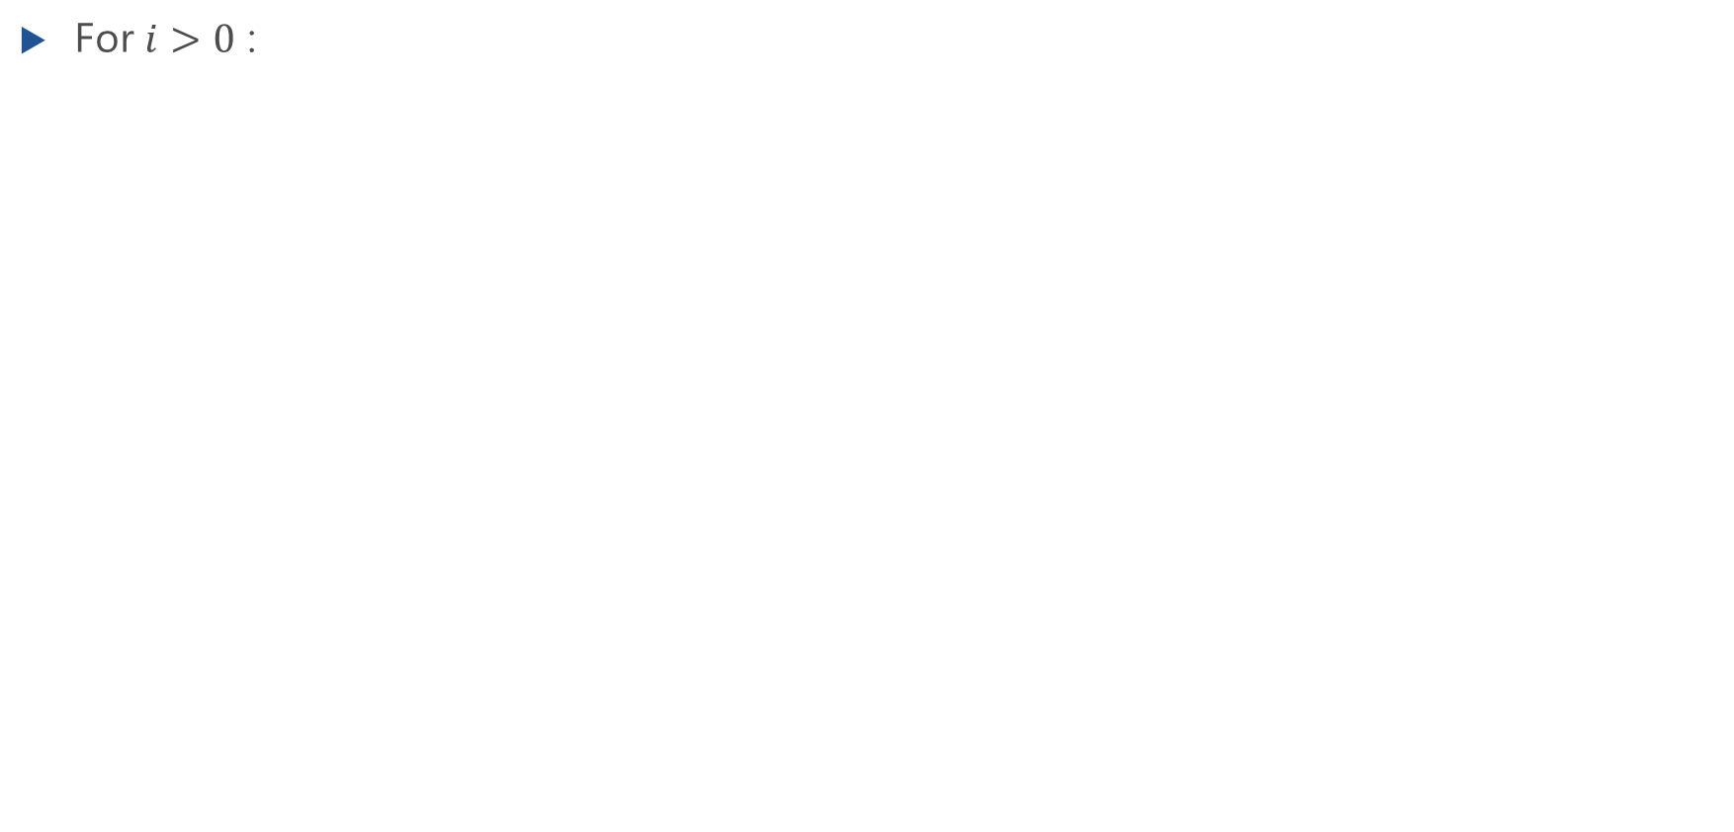
State Transition Probability (Case a)
For $i>0$ :

Slide 11
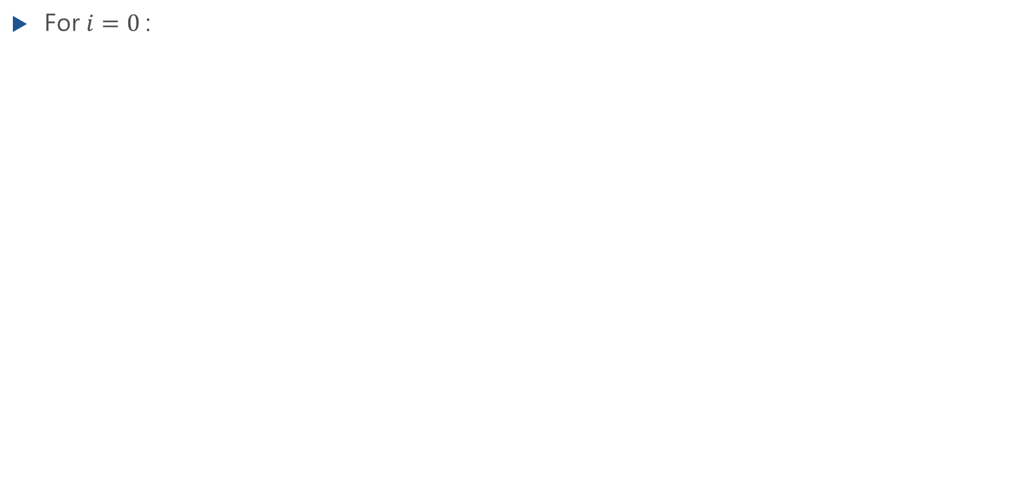
State Transition Probability (Case b)
For $i=0$:

Slide 12
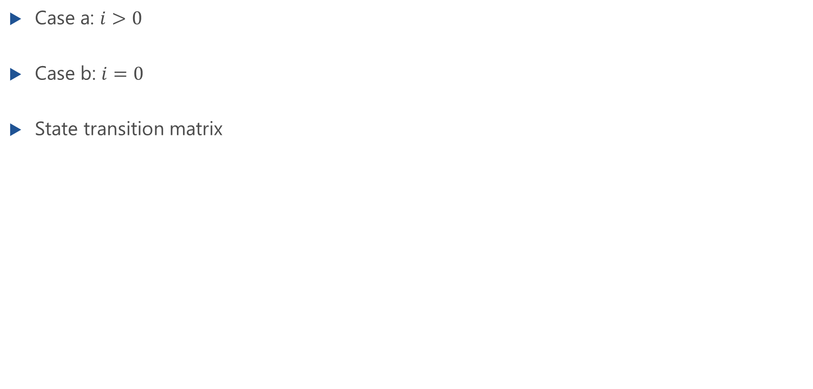
State Transition Matrix
Case a: $i>0$
Case b: $i=0$
State transition matrix

Slide 13
State Equation and State Probabilities

Slide 14
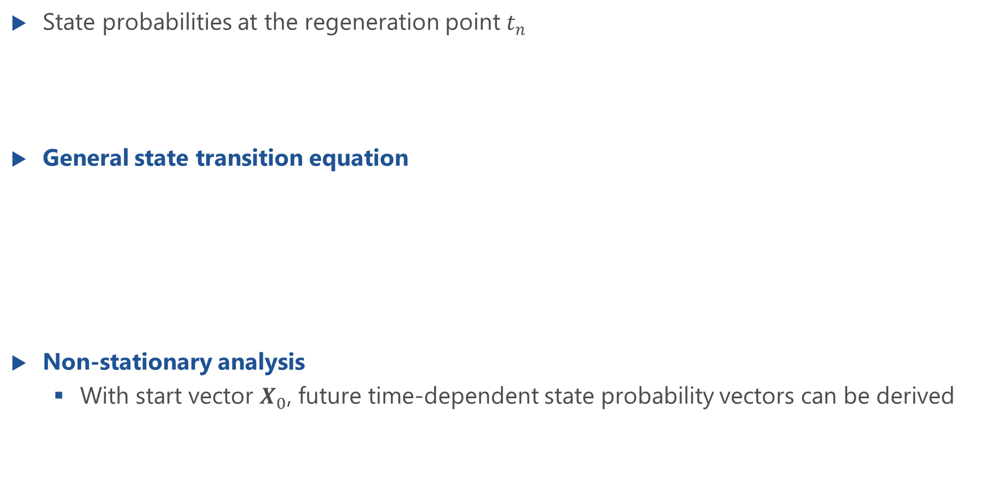
General State Transition Equation
State probabilities at the regeneration point $t_{n}$
General state transition equation
Non-stationary analysis
With start vector $X_{0}$, future time-dependent state probability vectors can be derived
case b: i=0
case a: i>0

Slide 15
Stationary Analysis
In statistical equilibrium
Stationary state transition equation
Components of state probability vector
case b: i=0
case a: i>0

Slide 16
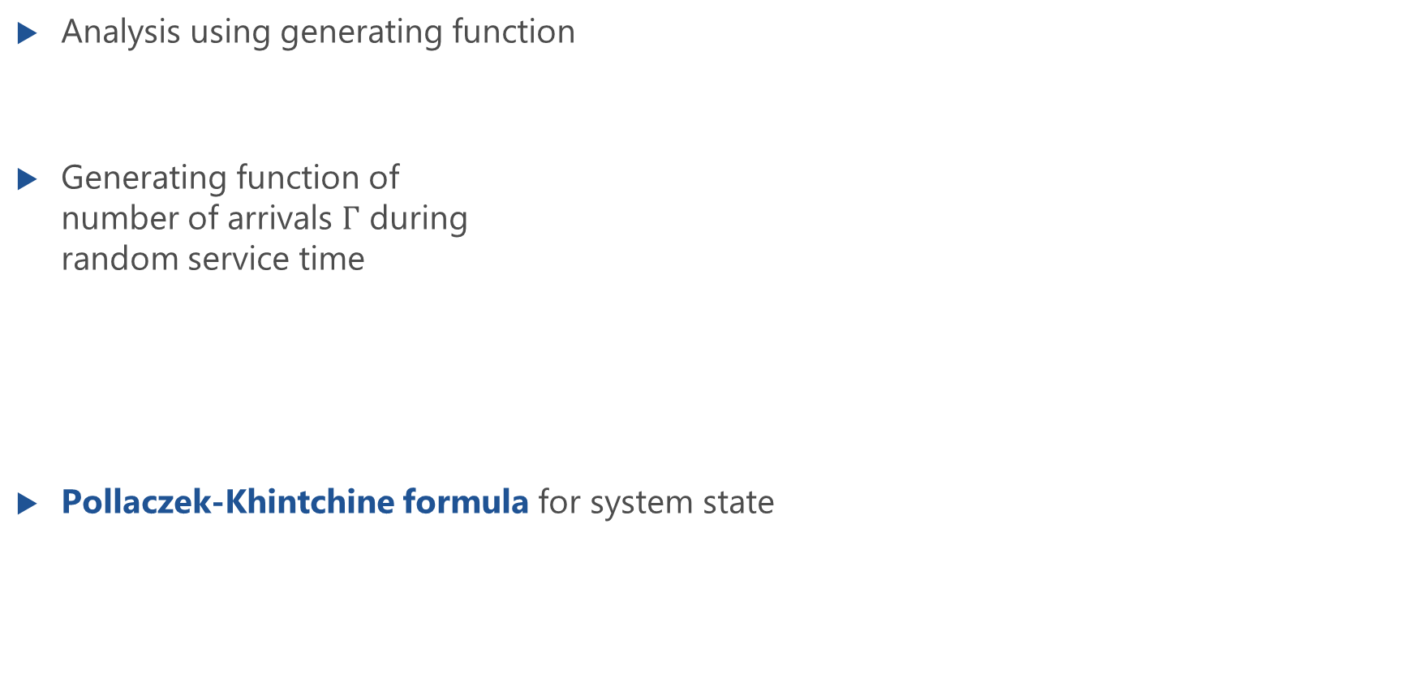
M/GI/1: Analysis of States
Analysis using generating function
Generating function of number of arrivals $Γ$ during random service time
Pollaczek-Khintchine formula for system state

Slide 17
M/GI/1: Analysis of States (Proof)
Lecture

Slide 18
Delay Distribution

Slide 19
Sojourn Time of Customer

Slide 20
Key Idea to Derive Delay Distribution
Interpretations of the state probabilities at embedding times (after service ends)
x(k) = P(test customer left behind X = k customers in system)
= P(k arrivals during the sojourn time of test customer)

Slide 21
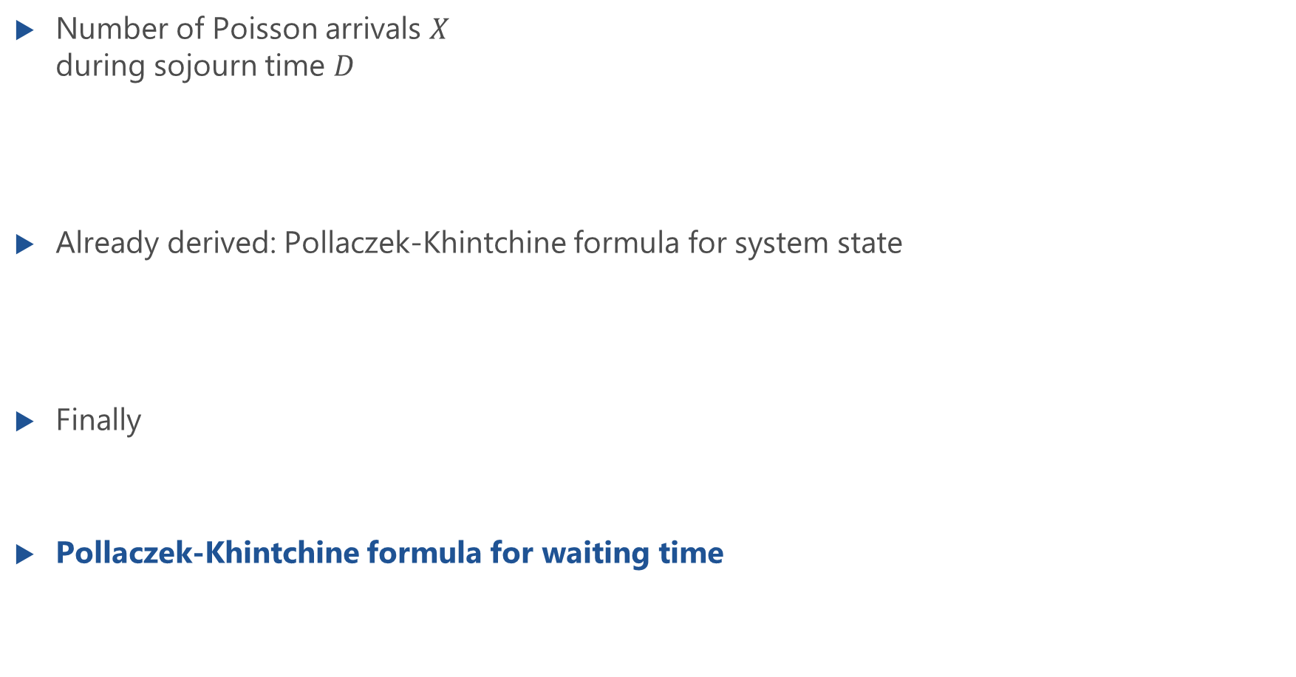
Delay Distribution: Analysis
Number of Poisson arrivals $X$ during sojourn time $D$
Already derived: Pollaczek-Khintchine formula for system state
Finally
Pollaczek-Khintchine formula for waiting time

Slide 22
Convolution Theorem for Continuous R.V.s
Lecture

Slide 23
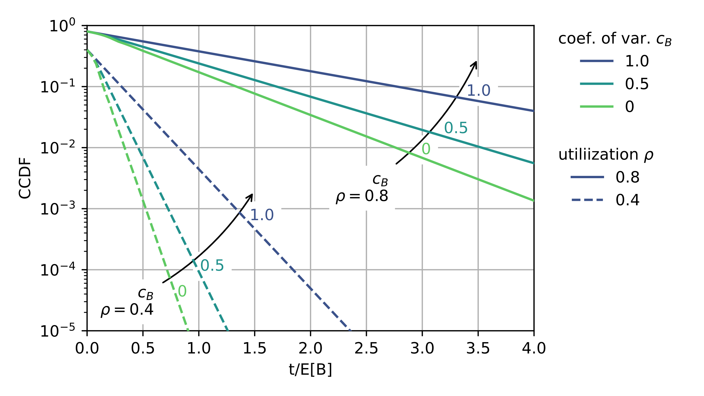
CCDF of the Waiting Time

Slide 24
Other System Characteristics
Waiting probability, mean waiting times, higher moments of waiting time

Slide 25
Waiting Probability
Initial value theorem of Laplace transform applied
Waiting probability
LT
LT

Slide 26
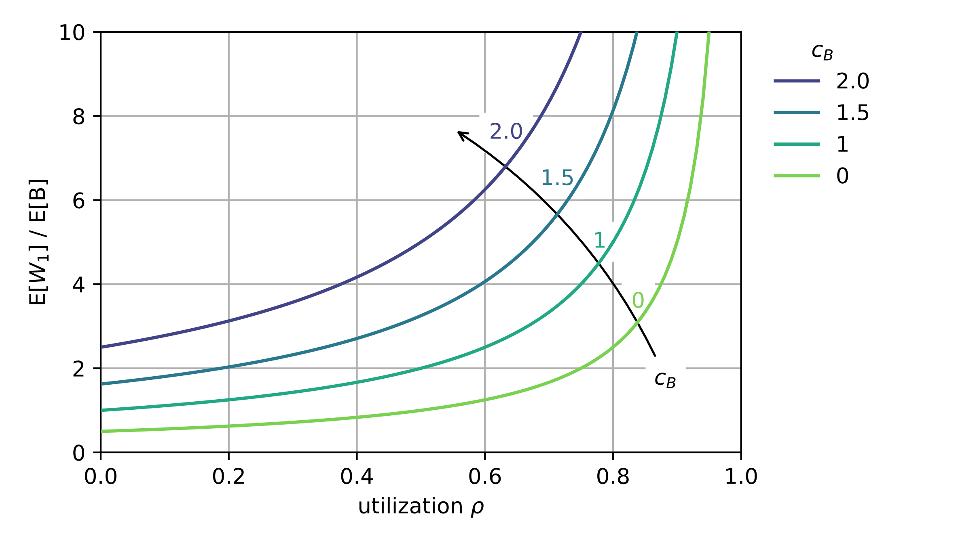
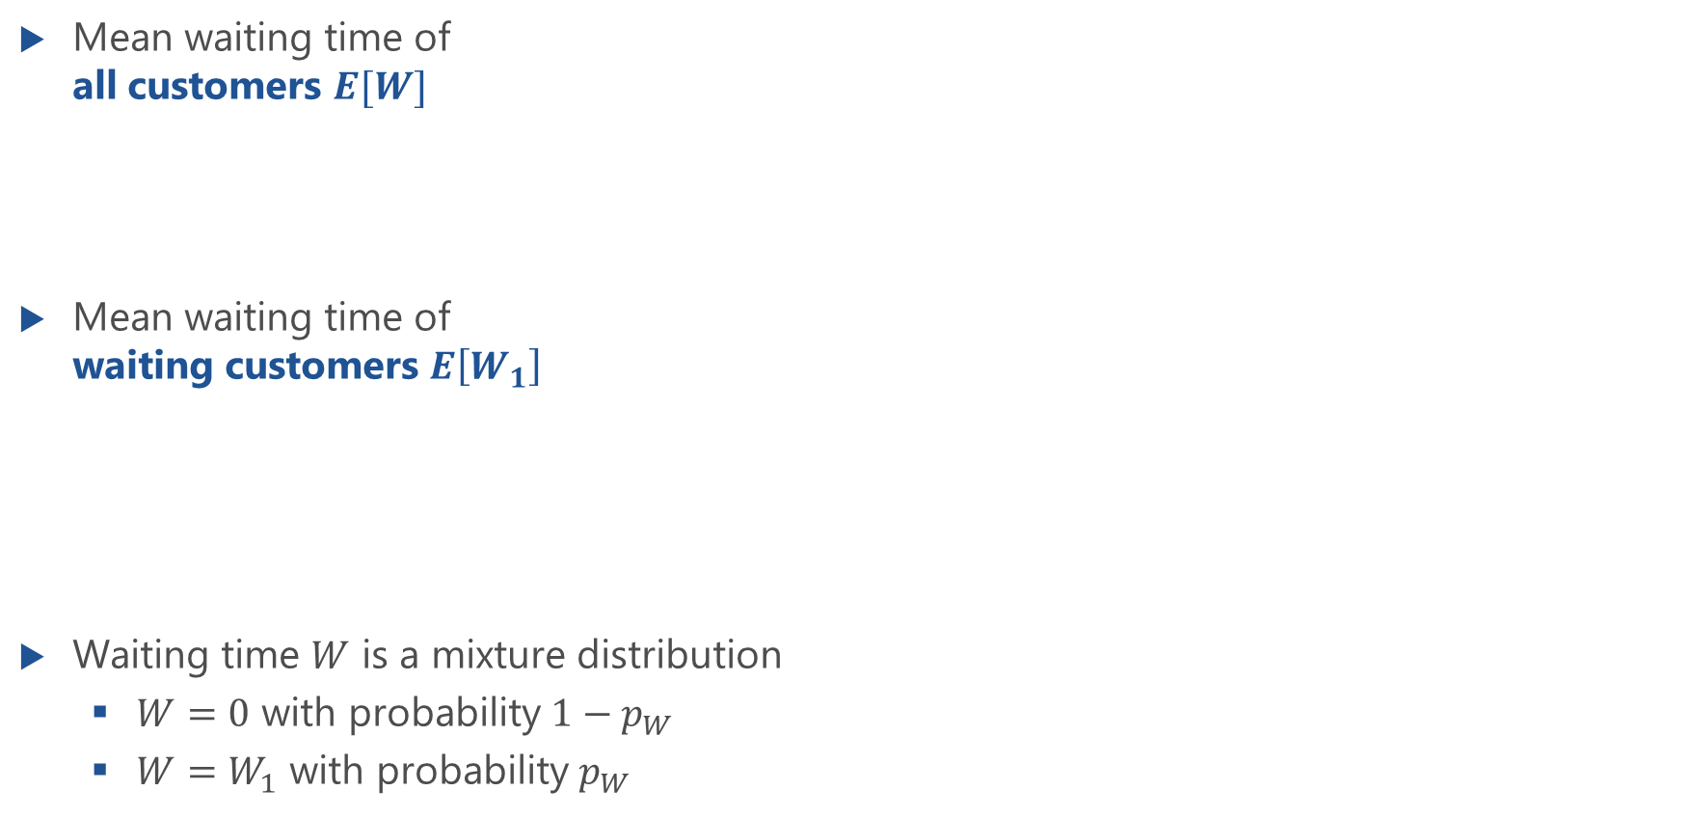
Mean Waiting Times
Mean waiting time of all customers $E[W]$
Mean waiting time of waiting customers $E\left[W_{1}\right]$
Waiting time $W$ is a mixture distribution
$W=0$ with probability $1−p_{W}$
$W=W_{1}$ with probability $p_{W}$

Slide 27
Higher Moments of Waiting Time
Takács recursion formula
Especially for the two first moments

Slide 28
State Probabilities at Arbitrary Time

Slide 29
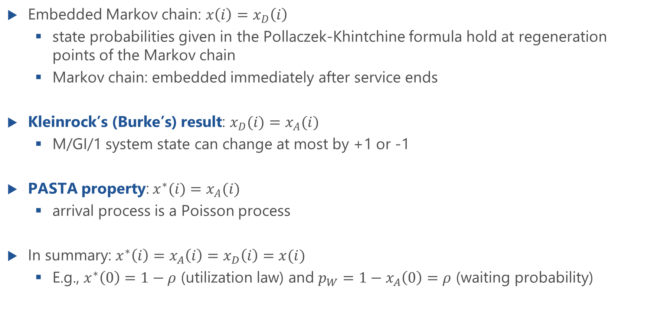
State Probabilities at Arbitrary Time
Embedded Markov chain: $x\left(i\right)=x_{D}\left(i\right)$
state probabilities given in the Pollaczek-Khintchine formula hold at regeneration points of the Markov chain
Markov chain: embedded immediately after service ends
Kleinrock’s (Burke’s) result: $x_{D}(i)=x_{A}(i)$
M/GI/1 system state can change at most by +1 or -1
PASTA property: $x^{∗}(i)=x_{A}(i)$
arrival process is a Poisson process
In summary: $x^{∗}\left(i\right)=x_{A}\left(i\right)=x_{D}\left(i\right)=x(i)$
E.g., $x^{∗}\left(0\right)=1−ρ$ (utilization law) and $p_{W}=1−x_{A}\left(0\right)=ρ$ (waiting probability)

